Slide 1




CTF
Getting ready for the Crazy
By Deano B00091839@student.itb.ie

Slide 2

!!! WARNING !!!
I and the Hacker Soc will not be responsible for your mistakes or actions with the information you will learn from this or any talks or workshops you participate in.

Slide 3
What Is A CTF
CTF = Capture The Flag
Semi - Officially an Esport
Cyber Security events
  Sometimes Hacking
  Sometimes Strategic Thinking

Slide 4

Why Do we Do CTFs
Learn To Drive By Reading a book
Learn -> Apply -> Understand
  We Enjoy games
  We learn Skills and Theory at the Same time
  We Get to put that Theory in Practice

Slide 5
Want to Work as a PenTester
Security Testing “IS NOT XYZ TOOLS”
Its about thinking outside of the box and coming up with solutions no one has thought of
It gets you thinking like a hacker / attacker

Slide 6
Type Of Challenges
Web / Network Attacks
  Finding Weaknesses in Web Applications and Servers
Forensics
  Searching for deleted or hidden information
Cryptography
  Finding weakness in cryptography and their implementations
Reverse Engineering
  Code Analysis static and dynamic
Exploitation
  Finding loopholes writing code to use them as evil
Recon
  Finding Information Not Usually Available
Trivia
  information such as who is “Serial Killer” and what movie is he from
Puzzles
  Algorithms, crosswords, sodoko …etc

Slide 7
Flag Types
Hidden or VERY HIDDEN alomost feeling impossible to access trough normal means
Types:
File – flag.txt
message – {thisIStheFlag}
String – Flag:F1@GflagFLAG
Series Of Characters – FLAG=~s#FAs45aSD*

Slide 8
A Simple Challenge
Words Misheard
Listen Carefully…
I run to escape a persecution.
The Eyes, They See.
The Flag is insatiable.
Category: Recon Points: 100

Slide 9
!!! Hint !!!
Pay Attention to the search results of “I run To escape a persecution”

Slide 10
!!! Hint: 2 !!!
Anagram
A word, phrase, or sentence formed from another by rearranging its letters: “Angel” is an anagram of “glean.”

Slide 11

!!! Solution !!!
The flag is
banalities
That is one-word anagram for insatiable
Reference : http://www.hsctf.com/

Slide 12
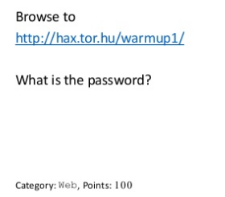
Find the Password

Slide 13

!!! Hint !!!

Slide 14
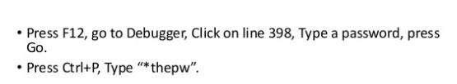
!!! Hint: 2 !!!

Slide 15

!!! Solution !!!

Slide 16
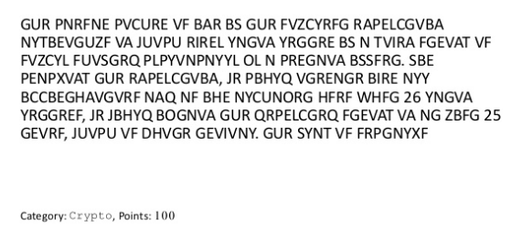
What Is The Secret Message

Slide 17
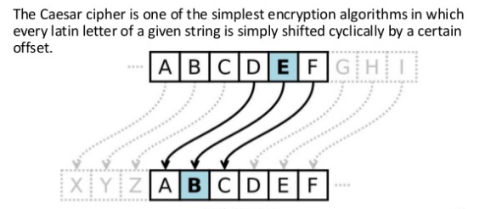
Hint

Slide 18
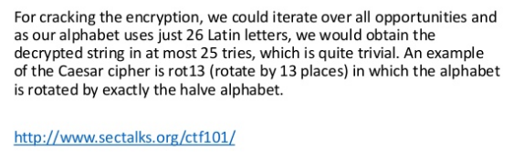
Hint 2

Slide 19
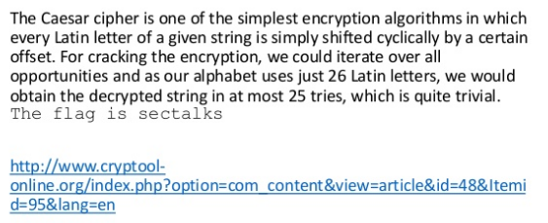
Solution

Slide 20
HOW TO BE A MASTER
Same Way You Get To Carnegie Hall
PRACTICE

Slide 21
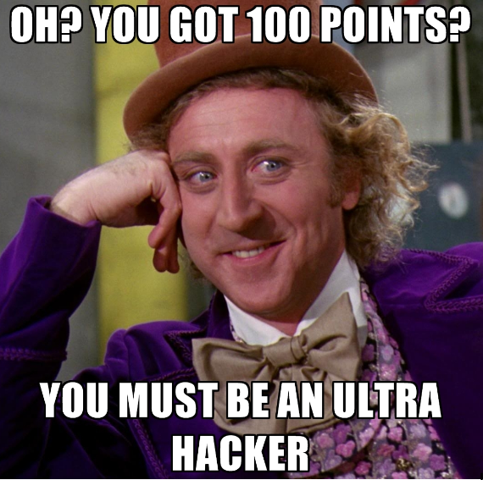
The Best CTF’s
ZeroDays – in person
Hack in the box – in Person
Hack The Box – Online
Hack This Site – Online
Root-me.org – Online
Just Google You'll Find 100s

Slide 22


